Slide 1
Extending Kubernetes API
API Server, custom API and custom resources

Slide 2

Objectives
Understand how to extend Kubernetes API
Application of extensions
Look at real some world examples of extensions

Slide 3
Overview
Part 1
Part 2
Intro into API Server (core API and structure), discovery
Extending the API Server with a custom API
Accessing the API Server via client libraries
Metrics server overview
Custom Resource Definitions (CRDs)
CRD controllers
Kubernetes operator library
Using Helm

Slide 4
API Server
Provides (mostly) REST API.
Exceptions: health checks.
Communicates with ETCD
API server gives access to the Kubernetes resources
and non-resource objects.

Slide 5
Kubernetes resources
Objects managed by Kubernetes:
pods, services, deployments
From Kubernetes docs:
”A resource is an endpoint in the Kubernetes API that stores
a collection of API objects of a certain kind; for example, the built-in pods resource contains a collection
of Pod objects”

Slide 6
Kubernetes non-resource objects
Metrics
Logs

Slide 7
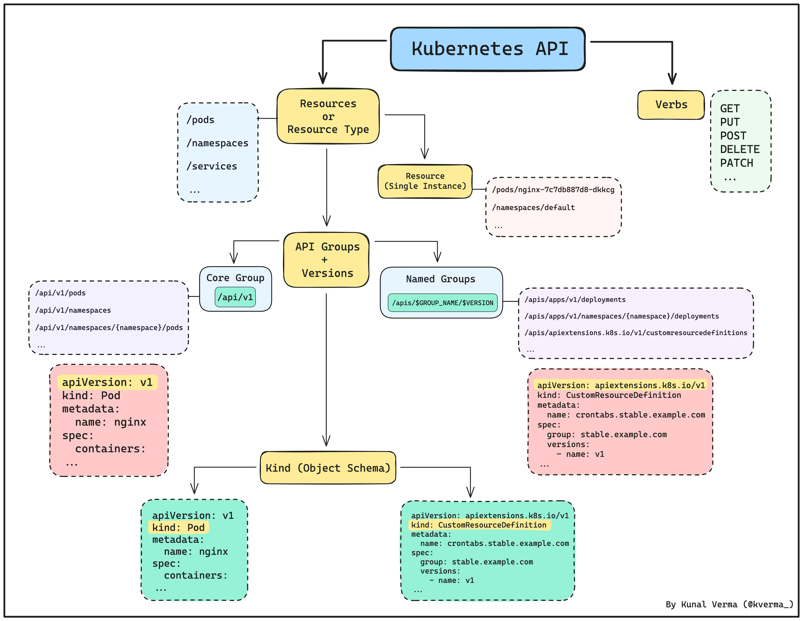
Kubernetes API structure

Slide 8
Questions?

